Slide 1


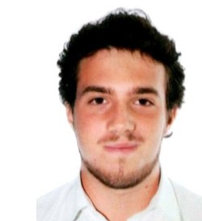




UML modeling of a monitoring system for Heart Failure patients
Implementation
Cristian Drudi
Eriberto Andrea Franchi
Francesca Ghiroldi
Mariapia Gioia
Alessandro Gozzi
Martina Mandorlini
POLIMI – 04/06/2020

Slide 2



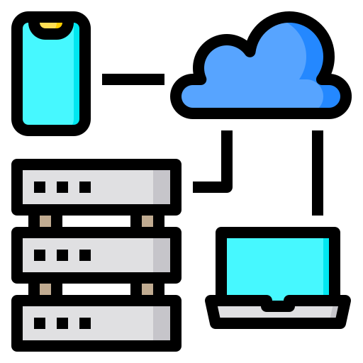


Introduction
Provide long term prevention
Collect information about patients with HF
Aims of the system
Improve transmission of information between patients and doctors
Supply constant monitoring
Reduce rehospitalization

Slide 3




Introduction – Project Implementation
Upload Parameters
View
Emergency Contact
Access
Medical Reports
Access
Therapy
Manage
Visits
Manage
Risk Evaluation Models
Upload
Parameters
Manage
Thresholds
1
Access
Server Statistics
Manage
Medical Reports
Manage
Therapies
Manage
Users
Manage
Questionnaires
Access
Patient List
Manage
Visits

Slide 4









Tables
Patient
SpecializedPractitioner
TechnicalAdministrator
Questionnaire
Question
Answer
QuestionnaireScore
ClinicalParameter
ClinicalParameterValue
Comorbidity
ComorbidityValue
MedicalProcedure
Orari
CUP
Therapy
Prescription
Incompatible
RiskEvaluationModel
Weight
PatientRisk
ServerParameter
Users
Questionnaires
Parameters & Comorbidities
Medical Procedure
Therapy
Risk Evaluation Model
Server Parameter

Slide 5
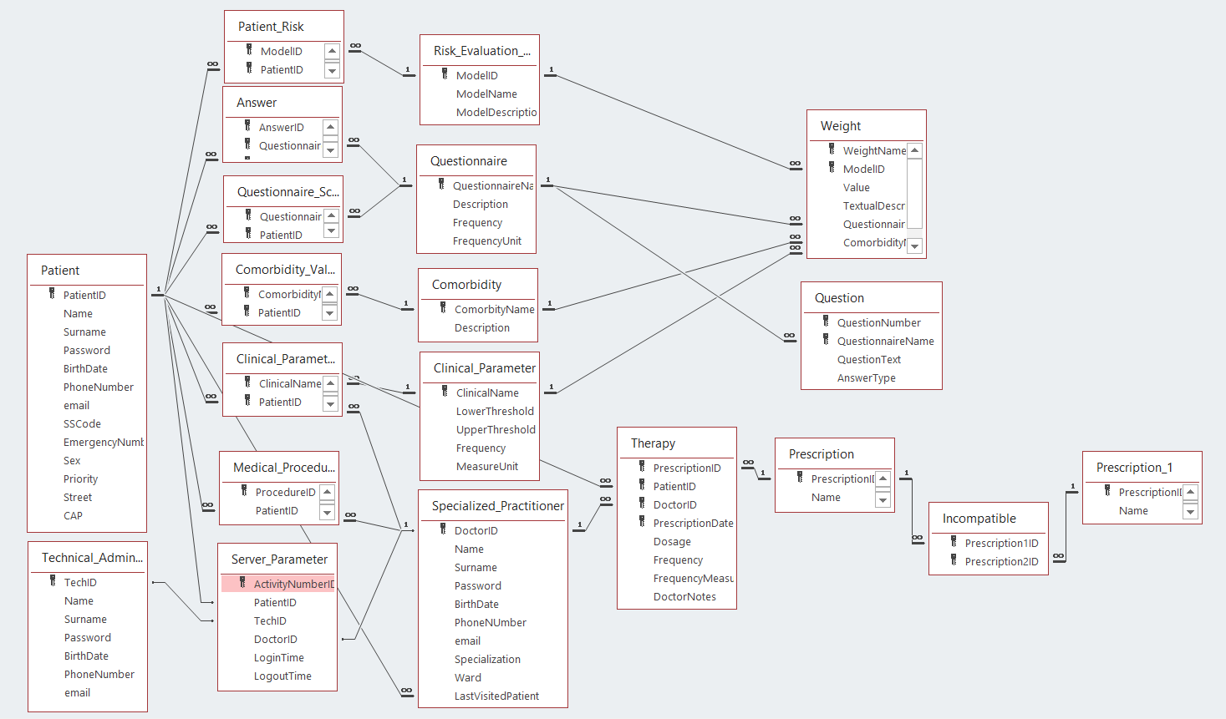
Relationships
Risk Evaluation Model
Questionnaires
Parameters & Comorbidities
Medical Procedure
Therapy
Users

Slide 6
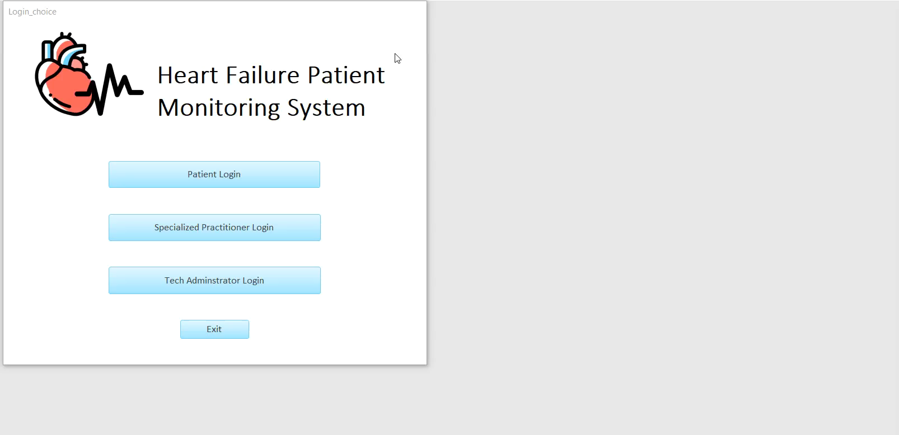
Specialized Practitioner
Login
Manage Therapies
Graphics & Statistics

Slide 7
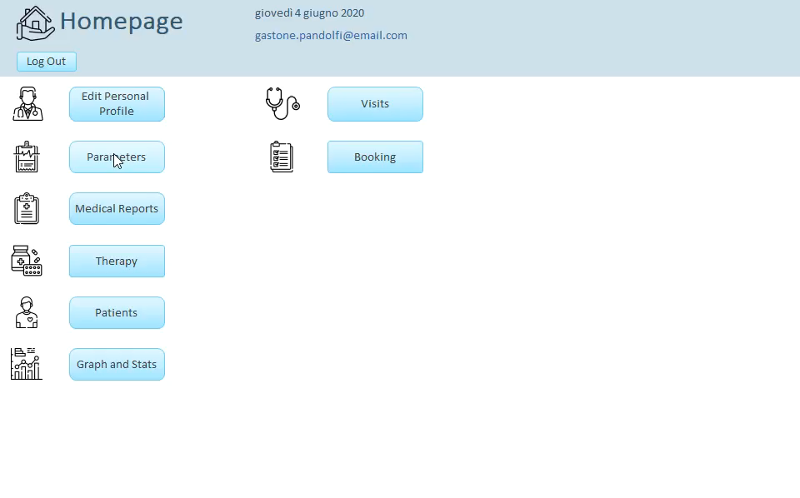
Specialized Practitioner
Parameters
Thresholds setting
Comorbidities
Manual Upload
Device Upload

Slide 8
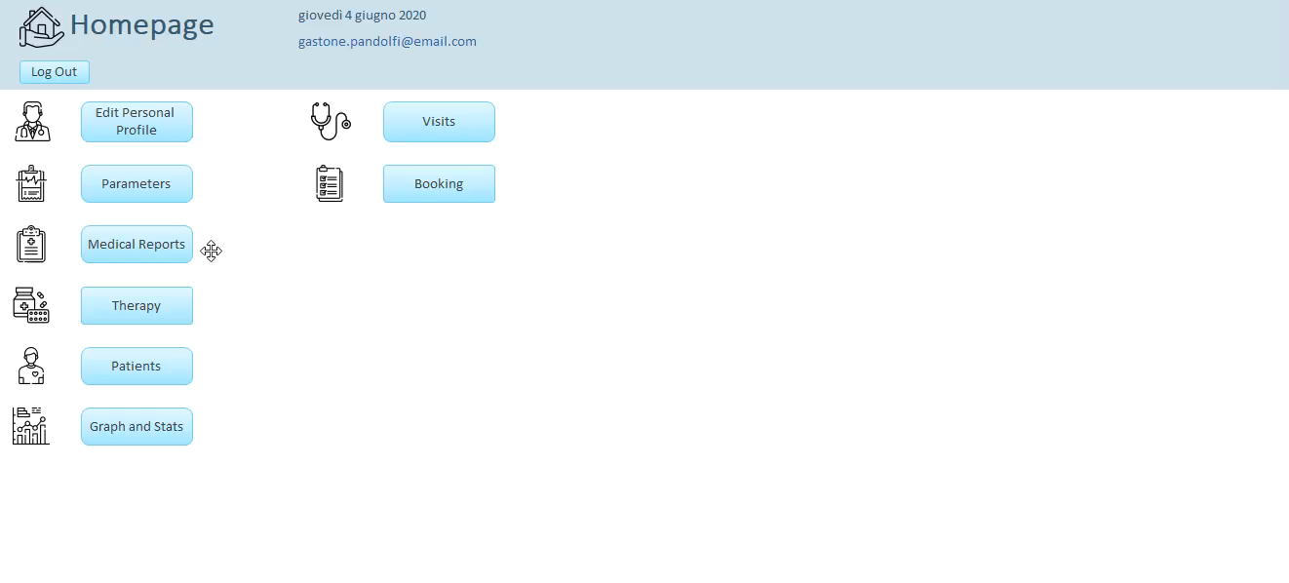
Specialized Practitioner
Medical Report

Slide 9
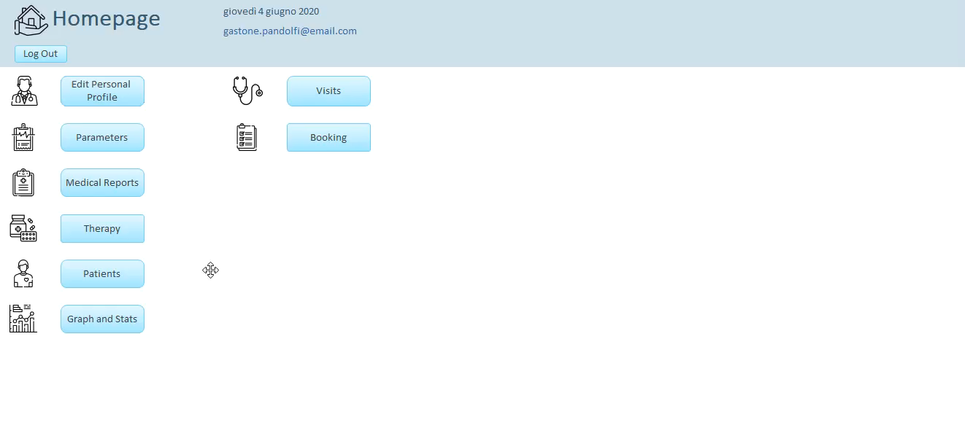
Specialized Practitioner
Patient
Patient Risk

Slide 10

Specialized Practitioner
Visit Procedure

Slide 11

Specialized Practitioner
Visit & Exam Booking

Slide 12
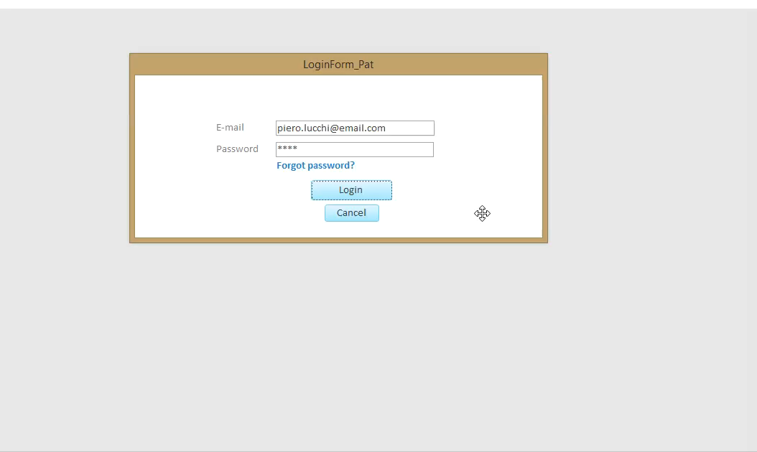
Patient
Login
Edit Profile
Paramters
Fill Questionnaires
Manual Upload
Device Upload

Slide 13
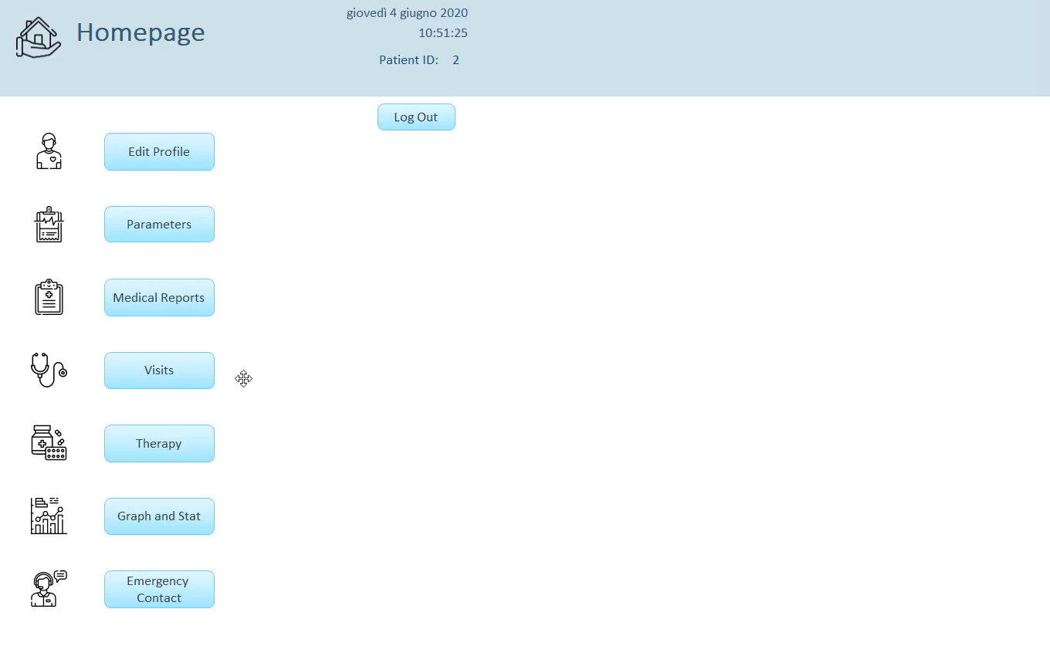
Patient
Manage Visits
View Therapies
Personal Graphs&Stats

Slide 14
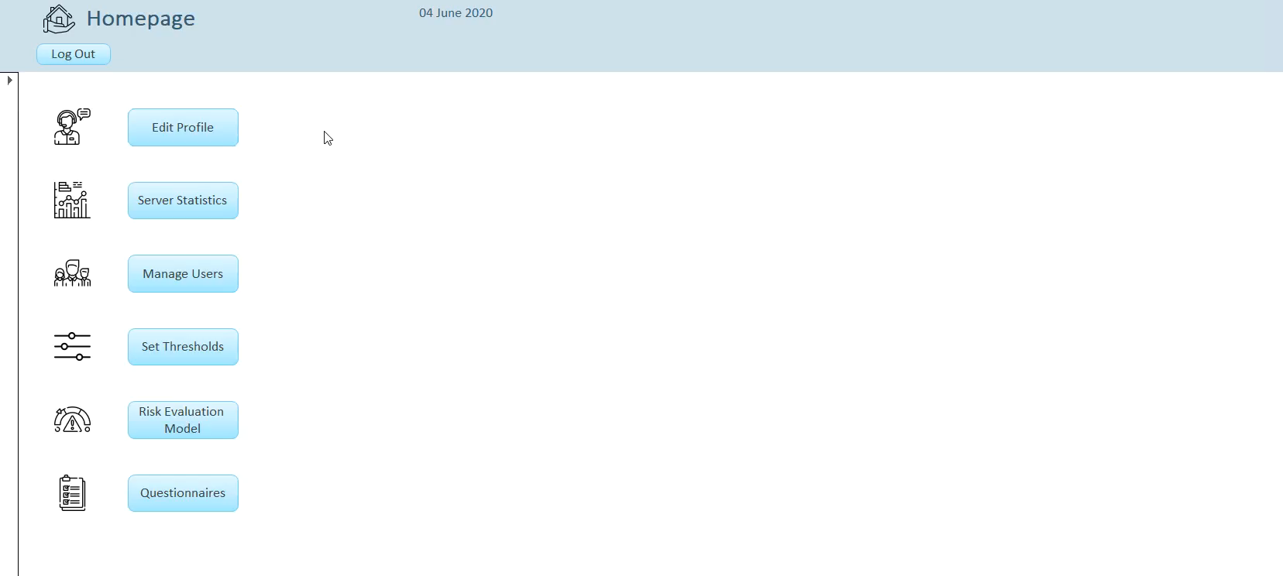
Technical Administrator
Edit personal profile
Manage Users

Slide 15
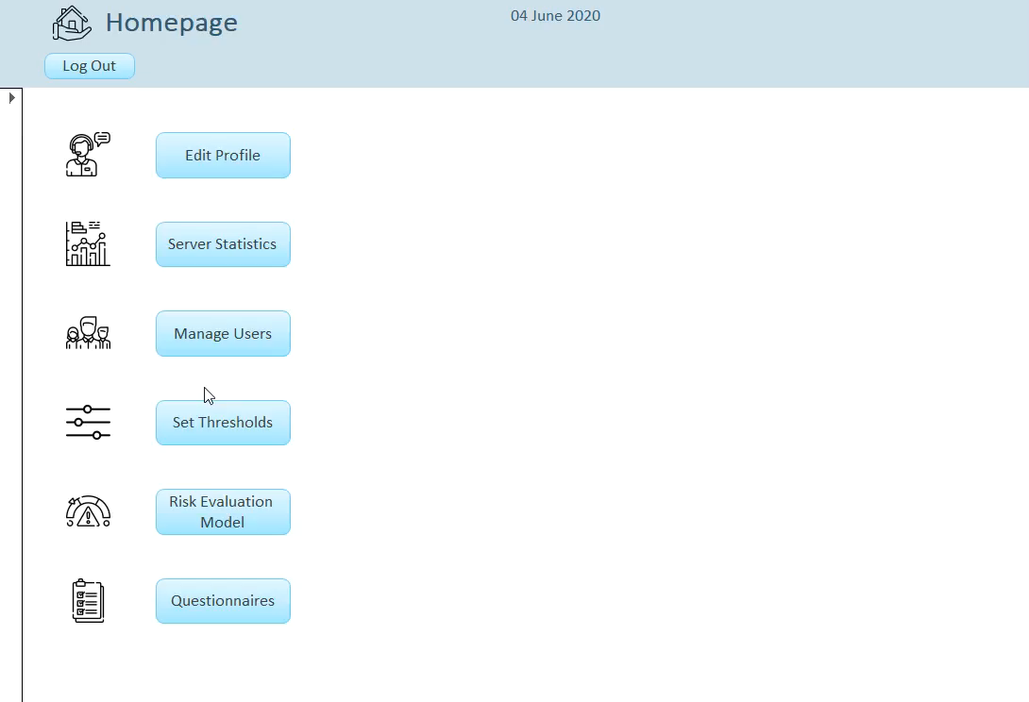
Technical Administrator
Manage thresholds

Slide 16
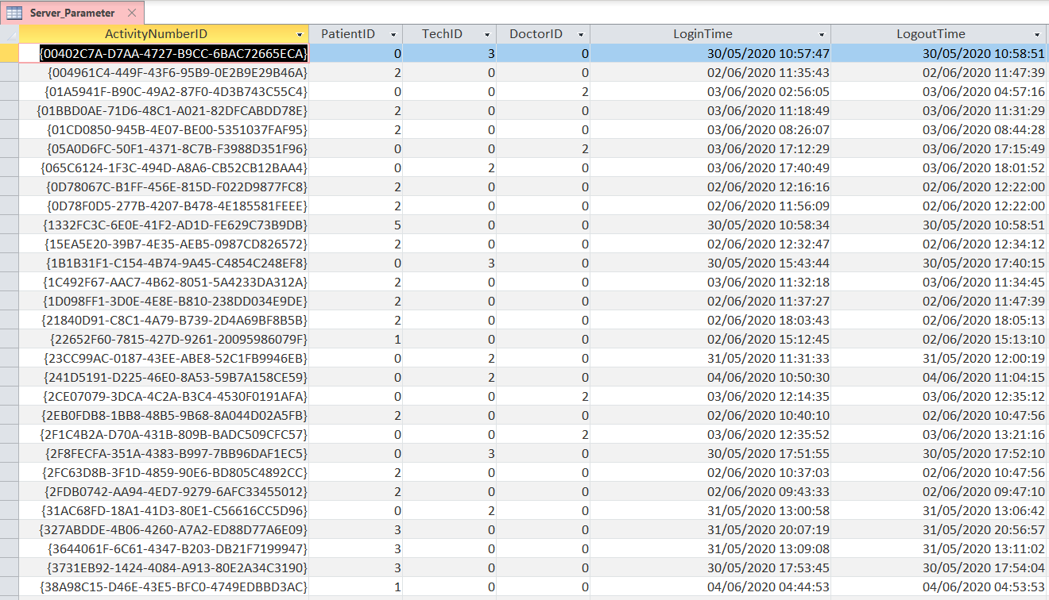
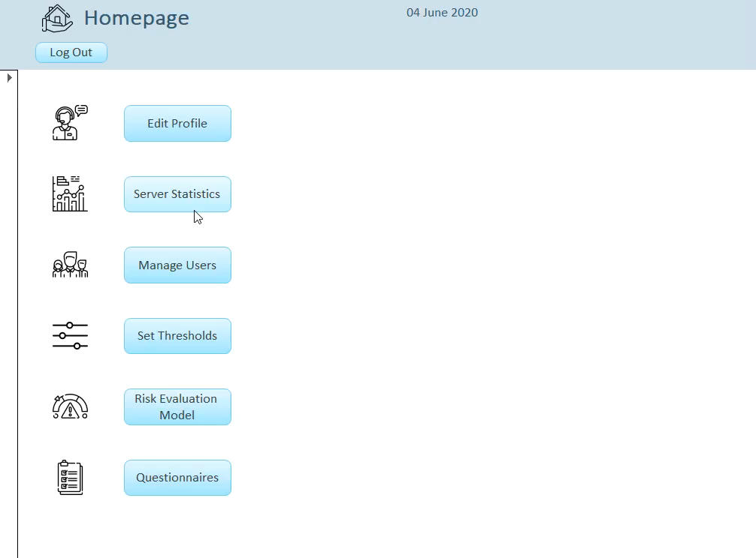
Technical Administrator
Access server statistics

Slide 17
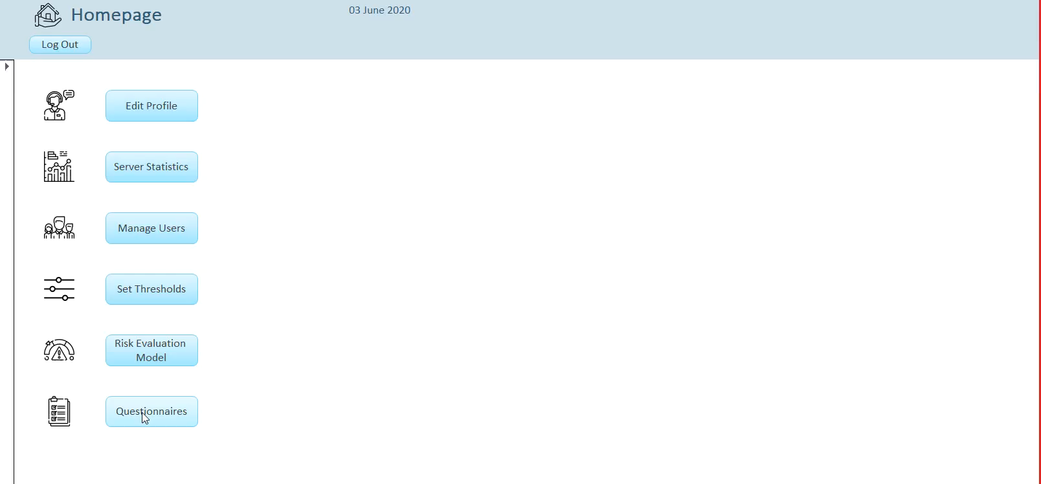
Technical Administrator
Manage questionnaires

Slide 18
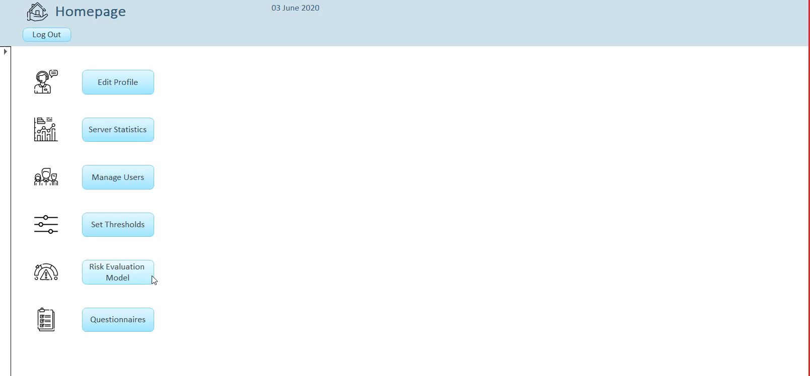
Technical Administrator
Manage risk evaluation model

Slide 19








Limitations and future work
Communication with mobile
devices
Risk level computation
Notification system
Improve graphics
Security issues
Implement educational guidelines
Multi user sessions
Video tutorials

